Slide 1
Ensemble Theory Bagging/Boosting
Sohail Dua
1322512
High Integrity Systems
Frankfurt University of Applied Sciences
sohail.dua@stud.fra-uas.de

Slide 2
Agenda
What is Ensemble Theory
Basic Ensemble Techniques
Max Voting
Averaging
Weighted Average
Bagging
Bagging meta-estimator
Random Forest
Boosting
AdaBoost
GBM
XGB
Light GBM
CatBoost
Stacking
Blending
Naive Bayes Classifier
Live Demo for Codes
Conclusion

Slide 3
What is Ensemble Theory
Idea
Combine the classifiers to improve the performance
Do not learn a single classifier but learn a set of classifiers
Motivation
reduce variance: results are less dependent on peculiarities of a single training set
reduce bias: a combination of multiple classifiers may learn amore expressive concept class than a single classifier

Slide 4
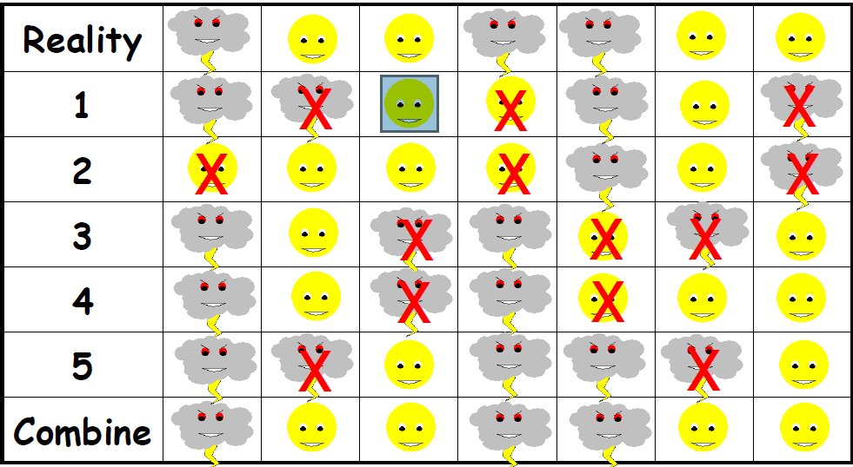
Ensemble Theory Example

Slide 5
Basic Ensemble Techniques
Max Voting
Used for classification problems
Multiple models are used to make predictions for each data point
Predictions which we get from the majority of the models are used as the final prediction.
Averaging
multiple predictions are made for each data point
used for making predictions in regression problems or classification problems
Weighted Average
All models are assigned different weights defining the importance of each model for prediction

Slide 6
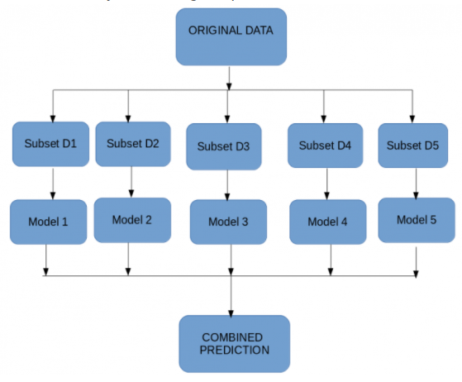
Bagging
combining the results of multiple models (for instance, all decision trees) to get a generalized result
create subsets of observations from the original dataset, with replacement.

Slide 7
Types of Bagging
Bagging meta-estimator:
Used for both classification (BaggingClassifier) and regression (BaggingRegressor) problems
A user-specified base estimator is used
Random Forest:
Extension of the bagging estimator algorithm
The base estimators in random forest are decision trees

Slide 8
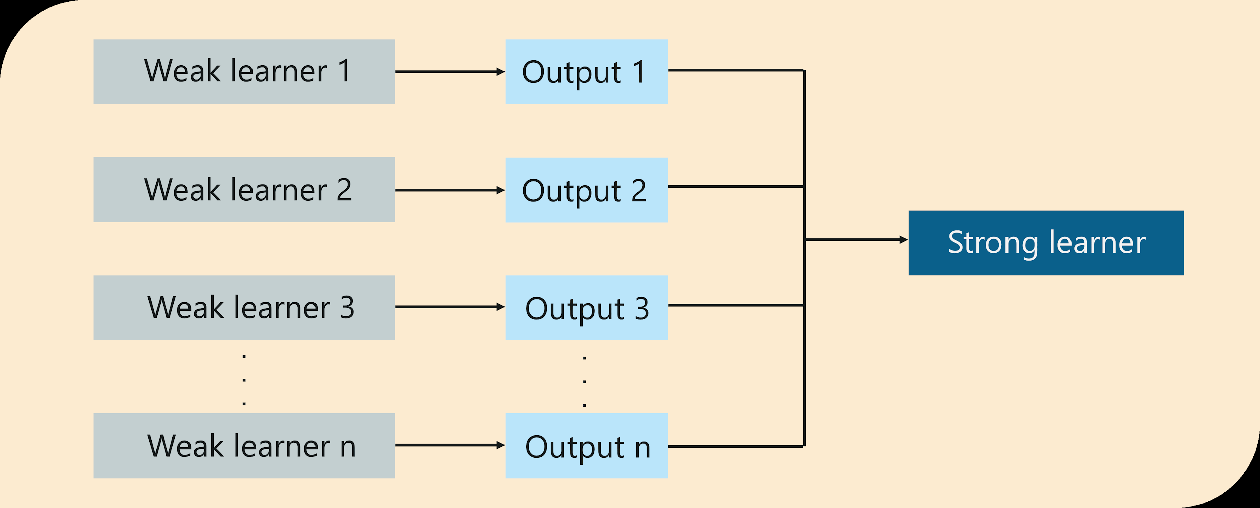
Boosting
Idea
each subsequent model attempts to correct the errors of the previous model
Steps
base algorithm reads the data and assigns equal weight to each sample observation
predictions that are actually false are identified by the base learner
false predictions are then assigned to the next base learner with a higher weightage on these incorrect predictions
repeating step 2 until this algorithm can correctly classify the output

Slide 9
Types of Boosting
AdaBoost
Decision trees are used for modelling
Multiple sequential models are created, each correcting the errors from the last model
assigns weights to the observations which are incorrectly predicted and the subsequent model works to predict these values correctly.
GBM
Algorithm that works for both regression and classification problems
Combining a number of weak learners to form a strong learner
XGBM
Advanced implementation of the gradient boosting algorithm.
High predictive power and is almost 10 times faster than the other gradient boosting techniques.
Reduces overfitting and improves overall performance.

Slide 10
Types of Boosting
Light GBM
Beats all the other algorithms when the dataset is extremely large
Follows leaf-wise approach
CatBoost
It deal with categorical variables
It does not require extensive data preprocessing

Slide 11
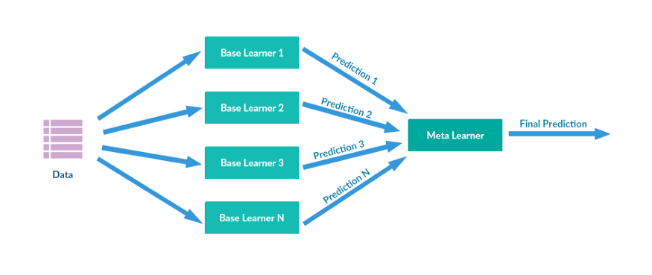
Stacking
Idea
Heterogeneous weak learners
Use k-fold cross validation
Train several models, usually with different algorithm types
Picking the best model, all the models are aggregated/fronted using another model
make the final prediction

Slide 12
Blending
Idea
can help us to improve performance and increase accuracy
Steps
The train set is split into two parts, viz-training and validation sets.
Model(s) are fit on the training set.
The predictions are made on the validation set and the test set.
The validation set and its predictions are used as features to build a new model.
This model is used to make final predictions on the test and meta-features.

Slide 13
Naive Bayes Classifier
A statistical classifier:
performs probabilistic prediction, i.e., predicts class membership probabilities
Foundation:
Based on Bayes’ Theorem.
Performance:
A simple Bayesian classifier, naïve Bayesian classifier, has comparable performance with decision tree and selected neural network classifiers
Incremental:
Each training example can incrementally increase/decrease the probability that a hypothesis is correct — prior knowledge can be combined with observed data
Standard:
Even when Bayesian methods are computationally intractable, they can provide a standard of optimal decision making against which other methods can be measured

Slide 14
DEMO FOR CODE

Slide 15
Conclusion
It is employed to train numerous learning machines and combining their outputs to obtain a better composite global model with more accurate and reliable decisions than can be accomplished through a single model
It has been used across various disciplines to improve the predictive performance of single models such as: bioinformatics, medicine, finance, manufacturing, information security, information retrieval and image retrieval

Slide 16
THANKS AND ANY QUESTIONS

